Slide 1


Department of Computer Engineering
Main Presentation
Under
Industrial Training Presentation(3CS7-30)
Session-2023-24(Odd)
Presented by
Student Name: ISHU KUMAR
Registration No.:PIET20CS080
Section: 3CS-B
Presented to
Faculty Name: ANITA KUMARI
Faculty Name: BHARAT THATHERA

Slide 2

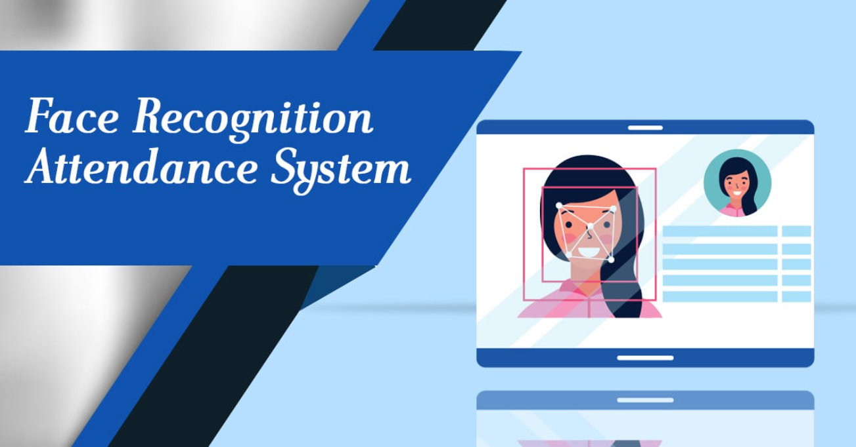
PROJECT TITLE
Automated Attendance System using Face Detection

Slide 3
Facial Detection and Recognition Technology for Attendance Tracking
1
Efficiency
2
Security
3
Accuracy
The Face Check Attendance System offers an efficient, accurate and speedy alternative to traditional attendance tracking methods, making it ideal for large organizations.
Attendance data is secure because the system uses facial detection and recognition technology, making it practically impossible for individuals to clock in for others.
The system is accurate
and reliable, while also
being easy to use.

Slide 4
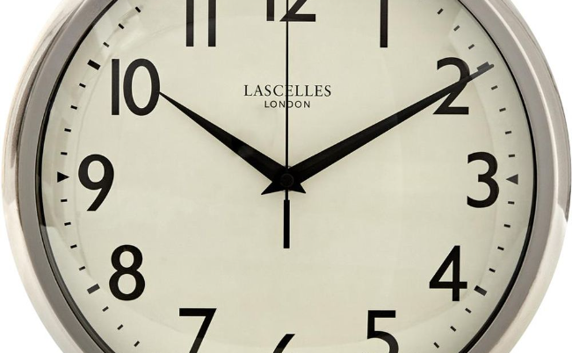
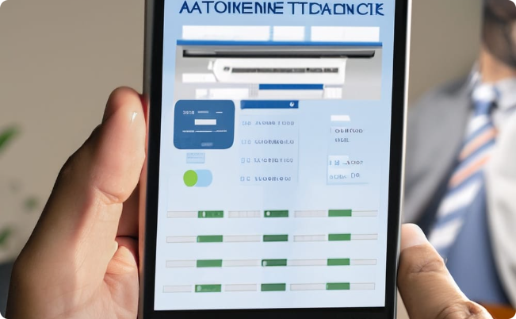
Benefits of an Automated Attendance System
Time-saving
Efficient
The Face Check Attendance System eliminates manual data entry and frees up time previously spent on attendance tracking for other essential tasks.
Automated attendance tracking ensures that the attendance data is accurate and available in real-time, making it easy to monitor attendance and track employee progress.

Slide 5
Features of the Attendance System
Flexibility
Easy integration
User-friendly
FaceCheck Attendance System can be easily integrated with your workplace environment, including other HR systems.
The system is easy to install and does not require significant technical knowledge, making integration effortless.
The system is straightforward and easy-to-use, helping businesses to save time and streamline their attendance tracking processes.

Slide 6

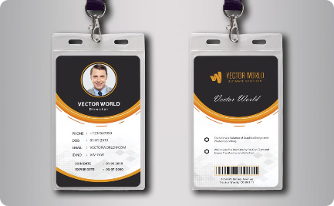

Comparison with Traditional Methods
Manual Attendance Tracking
ID Card System
Face Detection System
Traditional methods of attendance tracking require a lot of time and manual paperwork, making it inefficient and inaccurate.
Swipe card attendance systems have the potential for errors, such as misplacing ID cards, leading to inaccurate attendance data.
The system is more accurate and efficient, eliminating the drawbacks of traditional methods and provides a secure way of attendance tracking.

Slide 7
Implementation Process
1
Needs Assessment
Analyze the current attendance tracking process and identify areas for improvement.
Installation
2
Install the software, necessary hardware and customize it to suit your organization's needs.
3
Testing and Deployment
Thoroughly test the system for accuracy and efficiency in a real-world scenario, then deploy for everyday use.

Slide 8
Conclusion and Summary
The Solution
The Benefits
The Implementation
The FaceCheck Attendance System uses facial detection and recognition technology that revolutionizes attendance tracking.
The system saves time, is efficient, and secure, making attendance tracking easier for both small and large businesses.
The implementation of the system is straightforward and easy, requiring little technical expertise for successful integration.

Slide 9
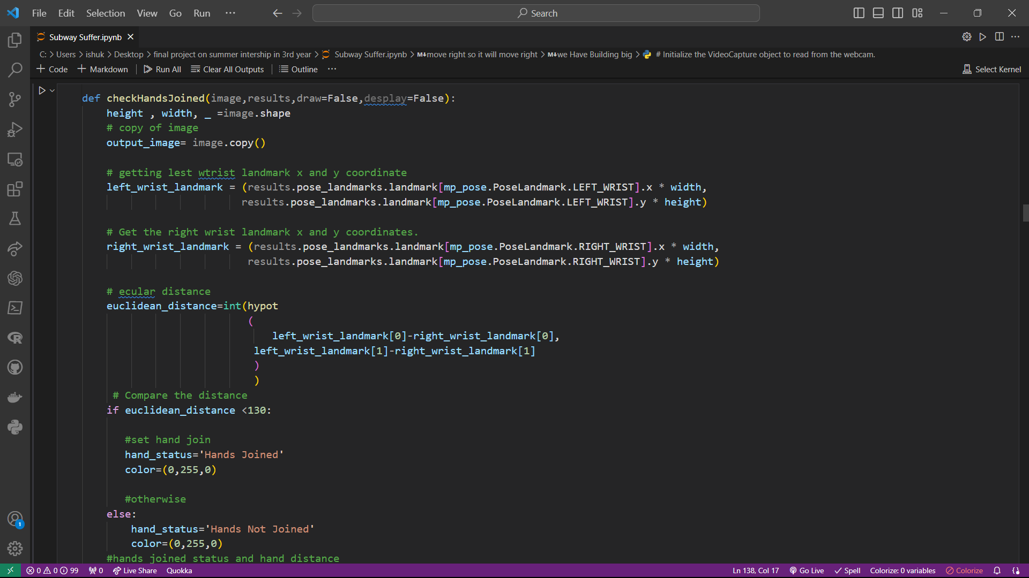

Slide 10
Time To Demo ...

Slide 11
Thank you😊.

